Slide 1
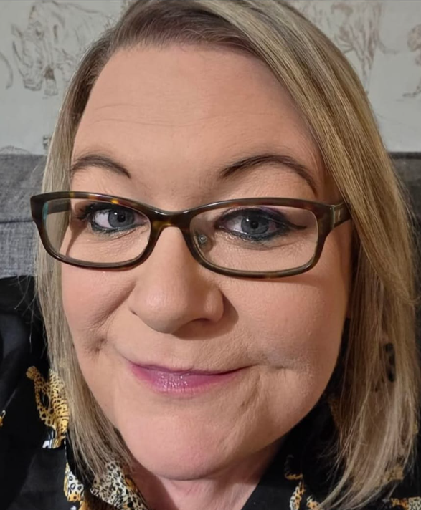
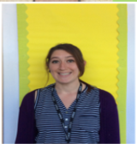
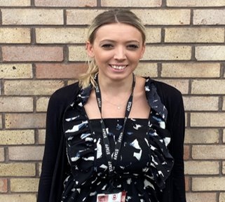
Welcome to Year 1
Miss Flack Miss Allen and Mrs Cooper

Slide 2
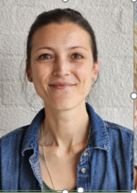
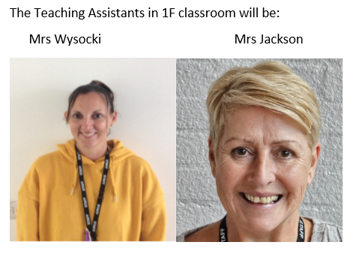
SUPPORT STAFF
The Teaching Asistant in 1AC will be Miss West.

Slide 3
ON THURSDAY AFTERNOONS MR BISHOP WILL BE TEACHING 1AC.
ON FRIDAY AFTERNOONS MR BISHOP WILL BE TEACHING 1f.

Slide 4
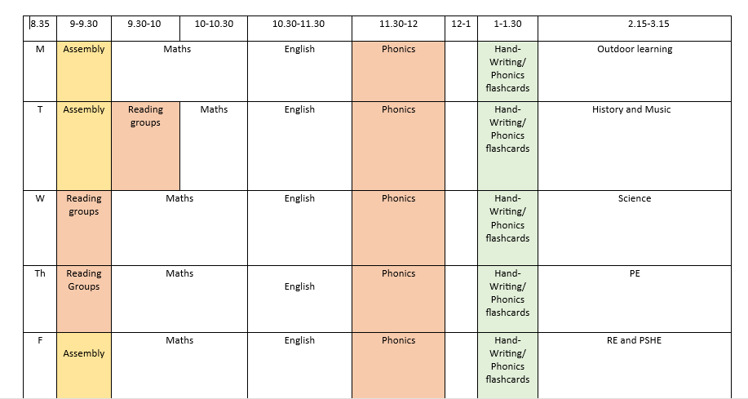

Slide 5
Phonics
At Perdiswell, we follow Little Wandle Phonics. Home reading books are sent home weekly. These books are designed to reinforce the phonics programme that the children are following. Children are assessed regularly and moved phonics group accordingly.
The children will follow a daily program of phonics. This will take place for around 30 minutes each morning. They have additional reading groups 3 times a week.
Reading is a key part of the children’s learning and we ask that you try to read with your child at home as much as you can. Please record when you have read with your child in their reading record.

Slide 6
Phonics Screening 2027
Every child in Year 1 is required to complete the phonics screening check.
This year’s phonics screening will take place throughout the month of June.

Slide 7
SEND at Tudor Grange Perdiswell
SENDCo – Mrs Lucy Brooks.
The first line of support for all children with SEND is Quality First Teaching in the whole class. Lesson content is scaffolded to ensure all children have the support in place to be able to make progress. A range of resources are made available to ensure all children have strategies they can use to support their learning.
If children need additional support in lessons, this will be allocated and delivered by a support assistant.

Slide 8
If your child is on the register for SEND, they will have a Pupil Passport. This document is written by class teachers and parents. It is reviewed termly and new targets included if previous targets have been achieved. You will be invited to a termly meeting with your child's class teacher to discuss their passport and you will have a copy to keep at home.
Please see the school website for our school SEND information report for more details around our Graduated Response to SEND.

Slide 9


PE
Please ensure that your child is wearing their PE kit on their set PE day. (This includes trainers). They must also wear their blazer over the top.
If possible, please keep earrings out for the PE day.
Our first two units for PE will be fundamentals and fitness.

Slide 10

E-safety
E-safety is a high priority at Perdiswell. Children have weekly E-Safety lessons in school but we need your help at home.
Talk to your children about what they are looking at online and who they are talking to.
We encourage you to check your child’s devices weekly and that the content, and conversations they are having are appropriate for their age group.
WhatsApp and Snapchat groups can become an issue even when these conversations are taking place outside of school. Children talk to their friends at home, sometimes get carried away by what they are saying and become unkind and hurtful towards others. This can have a significant impact on all children involved.
TikTok is another popular app, there can be inappropriate videos on the app, please be vigilant.
At Perdiswell, we take Online safety extremely seriously and all staff have access to The National Online Safety website for training, lessons and advice.
As part of our membership, all parents and carers have access to the website. A letter will be sent out in the next few weeks so you can access it for any support.
Please come and see us or Mrs Evans if you are concerned about any E-safety issues.

Slide 11
Homework
Reading – please ensure you are reading with your child every day at home. Books will be changed in school on a weekly basis.
Spellings – A half termly spelling list will be sent home.

Slide 12
Contacting Teachers
If you would like to speak to us, please email the Year 1 email address and we will reply or telephone you as soon as possible. We apologise, this may not be immediately unless you mark the email as urgent. This will prevent any congestion at the end of the day.
year1@perdiswell.tgacademy.org.uk

